Slide 1
Professional Status Committee 2016 Survey Results
Portland Biennial Conference
July 12, 2016

Slide 2
We got 261 responses to our survey (≈ 20% of LRW faculty)
33% − 405(c) or 405(c) track
26% − some form of tenure or tenure track
29% − ≤ 4-year, non- presumptively renewable K
6% − ≥ 5-year, non- presumptively renewable K
3% − adjunct or part-time
2% − visitors
.08% − unemployed

Slide 3
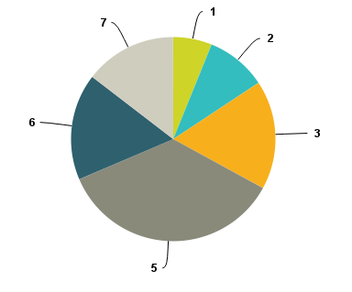
To what extent do we feel our institutions value us and our work? (Q.1)
33%
6%
15%
10%
17%
17%
36%

Slide 4
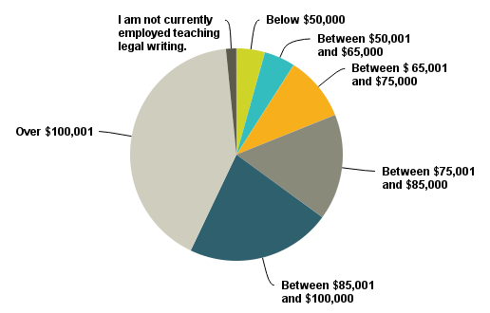
Current salaries (Q.3)
10%
10%
41%
16%
22%

Slide 5
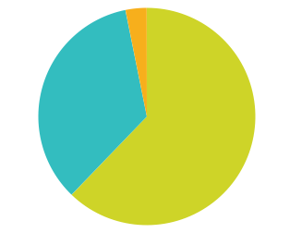
Salary changes last 18 months (Q.4)
Decreased
3%
Stayed the same 35%
Increased
62%
Notes:
I can’t figure out how to get rid of the fourth box

Slide 6
Other financial changes in last 18 months (Q.’s 5-6)
Travel funding
Research grants
YES25%
YES
15%
NO75%
NO
85%

Slide 7
What can we vote on? (Q. 8)

Slide 8
Are our voting rights changing? (Q. 9)
42% some positive results (e.g., cmte just formed to consider for LRW and clinical faculty)
39% mixed results (e.g., discussions but no change)
11% negative (e.g., now decanal app’ts w/o voting rights)
8% non-responsive
Unknown 6%
YES
20%
NO
74%

Slide 9
32% report faculty status changes (Q. 10)
E.g., “The faculty has endorsed a path to tenure.”
E.g., “Four faculty members did not have their contracts renewed at the end of the last school year.
E.g., “Positions that used to have 3-year caps no longer have caps but the positions are subject to national searches every 5 years .”

Slide 10
25% report changes in teaching load that did not affect other faculty (Q.11)

Slide 11
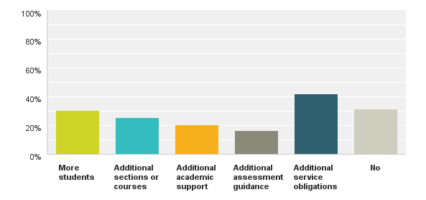
30% report they have taken on additional duties (Q.12)

Slide 12
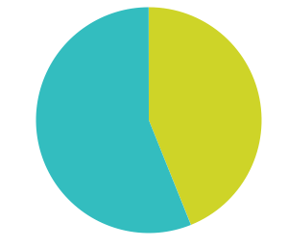
44% report a reduction in the number of people teaching legal research or writing at their school (Q.14)
YES
44%
NO
56%

Slide 13
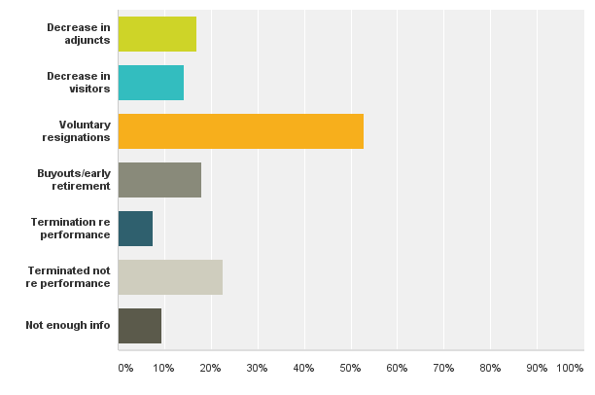
Reasons for reduction (Q.15)

Slide 14
How can we best help? (Q. 16)

